Slide 1


Reading Circuit Diagrams and Boolean Equations

Slide 2
Order of Operations
Brackets
Not
NAND
NOR
AND
OR

Slide 3
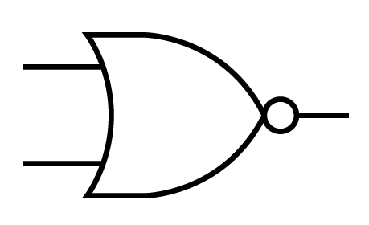
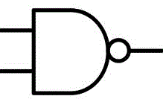
Y= A + (B x C)
A+(BxC)
A
Y
B
C
BxC

Slide 4


Y= A + (B x C) + D
A
A
A+(BxC)+D
BxC
B
Y
C
(BxC)+D
D
(BxC)+D

Slide 5

Y= B(B x C) x (C + C + A)
A
Draw the Entire Equation
B
Y
C

Slide 6
Y = (A x B) + (Ā + C)
Y = (Ā + B) x A(C + D)
Y = (B x B) + (A + B)A
Y = C x A + B + A x B x C

Slide 7
Y = (A x B) + (Ā + C)
A
B
Y
C

Slide 8
Y = (A x B) + (Ā + C)
A | B | C | Y
0 | 0 | 0
1 | 0 | 0
0 | 1 | 0
0 | 0 | 1
1 | 1 | 0
0 | 1 | 1
1 | 0 | 1
1 | 1 | 1
1
1
1
1
0
1
1
1

Slide 9
Y = (Ā + B) x A(C + D)
A
B
Y
C
D

Slide 10
A | B | C | D | Y
0 | 0 | 0 | 0
1 | 0 | 0 | 0
0 | 1 | 0 | 0
0 | 0 | 1 | 0
0 | 0 | 0 | 1
1 | 1 | 0 | 0
1 | 0 | 1 | 0
1 | 0 | 0 | 1
0 | 1 | 1 | 0
0 | 1 | 0 | 1
0 | 0 | 1 | 1
1 | 1 | 1 | 0
1 | 1 | 0 | 1
0 | 1 | 1 | 1
1 | 1 | 1 | 1
1
0
0
1
1
0
0
0
0
0
1
1
0
0
0

Slide 11
Y = (B x B) + (A + B)A
A
Y
B

Slide 12
Y = (Ā x B) + (A + B)
A | B | Y
0 | 0
1 | 0
0 | 1
1 | 1
0
0
0
0

Slide 13
Y = C x A + B + A x B x C
A
Y
B
C

Slide 14
Y = (ĀBC)+(ABC)+(ABC)+(ABC)
A | B | C | Y
0 | 0 | 0
1 | 0 | 0
0 | 1 | 0
0 | 0 | 1
1 | 1 | 0
0 | 1 | 1
1 | 0 | 1
1 | 1 | 1
0
0
0
0
0
0
0
1

